Slide 1
Fundamental of web design and development
lecturer: Anil Thapa

Slide 2
Team members
Mahesh Thapa (NPI000155)
Sajag Shrestha
Safal Acharaya
Rangin Basnet

Slide 3
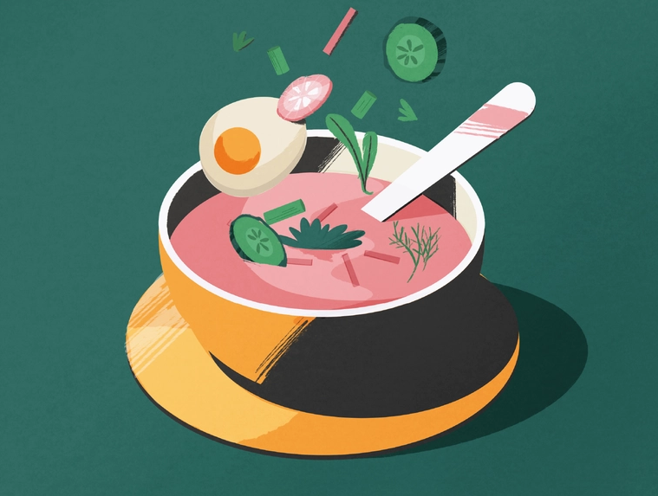
Introduction
Website is designed for health club named Green Well.
Club aim is to help people to live and maintain a healthy life.
Also include support group for smoking and alcohol addiction.

Slide 4
Story board and design documents
First meeting among group member was held to discuss about the creation of website.
Content are designed to match the theme and add the necessary things.
Website is created with HTML, CSS and java script.

Slide 5
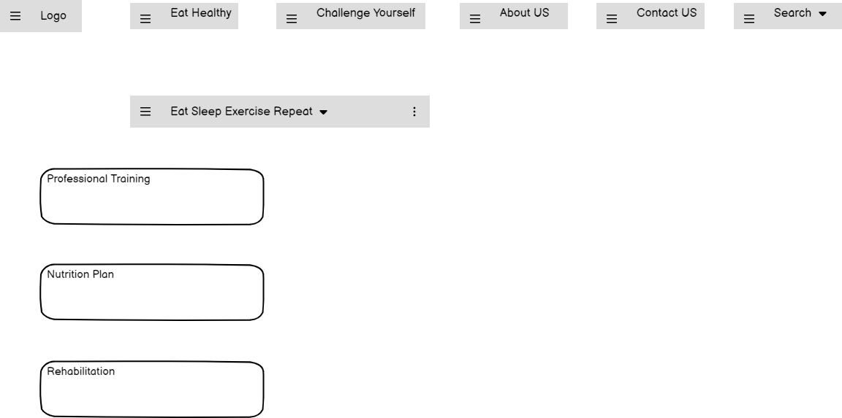
Wire Framing

Slide 6
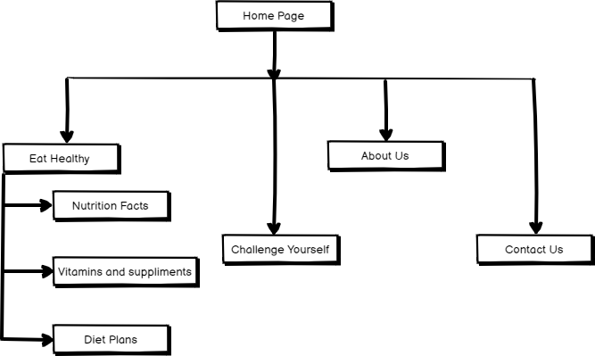
Story board

Slide 7

Story board

Slide 8

Navigation bar
Navigation bar is section of GUI, designed to help the visitors to access information.

Slide 9

Main interface design

Slide 10
Future enhancement
To provide better maintenance and the required updates.
To make the website responsive in best way as possible.
To improve the designs and style as well as placement of the contents of the site.

Slide 11
Conclusion
Website is created for health club named Green Well.
A complete functional website is designed by our team.
All multimedia components are used effectively.
HTML and CSS are used to built the website.
Java script is used to create dynamic and interactive web content.

Slide 12
Referencing
Future Enhancements (www.ncbi.nlm.nih.govn, Jan 3, 2001) : (https://www.ncbi.nlm.nih.gov/pmc/articles/PMC3116776/)
Web Design Principles of Successful Websites. (2022, June 21). Retrieved from Cleverism: https://www.cleverism.com/web-design-principles-successful-websites/
Web Site Publisher:: Future Enhancements. (2022, June 20). Retrieved from Cryer.co.uk:
http://www.eryer.co.uk/downloads/websitepublisher/future.htm#:-:text-Future Enha ncements Web Site Publisher is a free.be uploaded or%2 Odeleted before actually processing them.
19 Best Gym Websites Design Inspiration 2022. (2022, Dec 16). Retrieved from Colorlib: https://colorlib.com/wp/gym-websites-design/
50 Gorgeous Color Schemes From Stunning Websites. (2022, Dec 12). Retrieved from Visme Blog: https://visme.co/blog/website-color-schemes/
740 Web gallery ideas | web design inspiration, web design, interactive design. (2022, Dec 20). Retrieved from Pinterest: https://www.pinterest.com/1812ew/web-gallery/
8 Principles of Good Website Design. (2022, Dec 25). Retrieved from Astra: https://wpastra.com/good-website-design/

Slide 13
Andrew, P. (2022, Dec 14). 25 Login & Registration Forms with Creative Designs. Retrieved from Speckyboy Design Magazine: https://speckyboy.com/creative-login-registration/
FUTURE ENHANCEMENT OF WEBSITE DESIGNING AND DEVELOPMENT. (2021, July
Understanding Drug Use and Addiction DrugFacts. (2022, 07 12). Retrieved from National Institute on Drug Abuse: https://www.drugabuse.gov/publications/drugfacts/understanding-drug-use- addiction#:-:text-Drug addiction is a chronic disease characterize d by,ability to resist intense urges to take drugs.
03). Retrieved from dreamworthsolutions:
https://dreamworthsolutions.wordpress.com/2013/03/20/future-enhancement-of-website- designing-and-development/
How to fill empty space in your designs. (2022, Dec 16). Retrieved from Creative Bloq: https://www.creativebloq.com/web-design/closer-look-empty-states-91517042
How to Wireframe a Website - DreamHost. (2022, Dec 28). Retrieved from Website Guides, Tips & Knowledge: https://www.dreamhost.com/blog/how-to-wireframe-website/
Nemenman, M. (2022, Dec 24). 21 Beautiful Art Gallery Websites for Inspiration. Retrieved from InstantShift - Web Designers and Developers Daily Resource.: http://www.instantshift.com/2011/02/25/21-beautiful-art-gallery-websites-for-inspiration/
Objectives of a Nonprofit Organization. (2022, Dec 4). Retrieved from
Yourbusiness.azcentral.com: https://yourbusiness.azcentral.com/purpose-board-directors- nonprofit-organizations-12770.html
Practice, S. (2022, 10, 15). Yoga and Pranayam-Spiritual benefits and importance. Retrieved from SSRF English: https://www.spiritualresearchfoundation.org/spiritual- practice/spiritual-growth/yoga-pranayam-benefits-and-importance/

